Slide 1
Lynder
By: Ian Chiu, Maxwell Wang, Darren Chou
Notes:
Ian

Slide 2

What is Lynder?
Lynbrook
Youth
Nourishing
Deluxe
Effective
Ranker
Notes:
Darren

Slide 3



Meet the team
Darren Chou
JUnit/Testing
Ian Chiu
GUI guru
Maxwell Wang
Algorithm + Class structure
Notes:
Darren

Slide 4
Purpose
Noticed that Lynbrook students have difficulties making friends
Normally either random or terrible
Create fair groups that caters to the majority
Notes:
Darren

Slide 5


Lynder vs. Others
Better sorting algorithm
Scale of 1-5
More accurate
Not distracting to the user
No profile pictures
No advertisements
Truly non-profit organization
Notes:
maxwell

Slide 6
How to use it
Teacher:
Enter groupSize
Enter student names and gpa
Student
Rate other students from scale 1-5
Groups are created!
Notes:
Ian

Slide 7
Development
Algorithm implementation
Matching Algorithm
Per Student
Group Avg
Group Size
Fixed
Flexible
GUI
Developed the Input Student GUI
Calls on Rating GUI once complete
Developed the Rating GUI
Creates and calls upon a new Ratings GUI when completed
Developed the Start GUI
Calls on Input Student GUI
Notes:
algorithm
GUI Ian

Slide 8
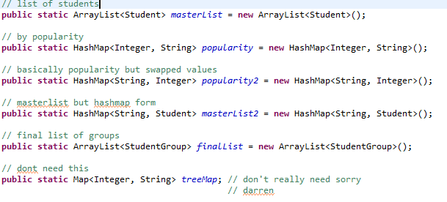
Data Structure and Algorithm
Landfill full of maps
Arraylists of Students
Students have Maps of Students
Selection Sort for popularity

Slide 9
Future Plans
Beautiful GUI for user satisfaction
Algorithm will take more factors into account such as extremities and outliers as well as a way to deal with left over children.
In the future, Lynder Incorporated will develop an all-new networking and artificial intelligence program, similar to IBM’s Watson and Google Home, that will further improve the pairing between groups! Expected to debut in 2118.
Notes:
Ian

Slide 10
Inquiries
IF interested in purchasing Stock or investing in our company, contact us!
maxwelllwang@gmail.com
ichiu731@student.fuhsd.org
dchou737@student.fuhsd.org
Response time 1 year.
Monday-Friday 7:30AM - 8:30AM.
Closed Wednesdays
Closed during the Summer.
Notes:
Ian

Slide 11
